Slide 1
Application of HMM in Credit Card Fraud Detection
by Nguyen Dang Vu

Slide 2
Content
I. Hidden Markov Model
II. Application in Fraud Detection
III. Example in Jupyter Notebook

Slide 3
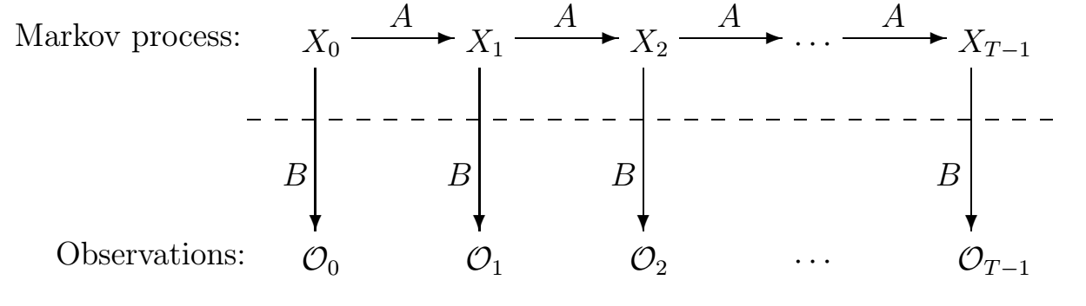
I. Hidden Markov Model
1. Basic Concept
A Hidden Markov model is a Markov chain for which the states are not explicitly observable.
Assumption: The probability of occurrence of an event at time ‘t’ depends only on the observation at time ‘t-1’ and not on the events that happened before ‘t-1’.
=> The observations O1,O2,...Ot-1 do not impact the observation Ot

Slide 4
I. Hidden Markov Model
1. Basic Concept
O : { O1, O2 , …. OT } : Sequence of observations
Q : {Q1 , Q2 , …. QT } : Sequence of corresponding hidden states
S : {S1 , S2, ……, Sn } : Set of unique states in the Hidden Markov model
M : {M1 , M2, ……, Mm } : Set of unique observations in the Hidden Markov model
n : Number of hidden states in the model
m : Number of unique observations in the model
T : Transition matrix (NxN: aij state Si → state Sj)
E : Emission matrix (NxM: aij: state Si → observation Mj)
Pi: Initial/ Start probability
T
T
T
Q3
T
Qt
T
Q1
Q2
E
E
E
E
O1
O2
O3
Ot

Slide 5
I. Hidden Markov Model
2. Example
Consider two friends, Alice and Bob, who live far apart from each other and who talk together daily over the telephone about what they did that day. Bob is only interested in three activities: walking in the park, shopping, and cleaning his apartment. The choice of what to do is determined exclusively by the weather on a given day. Alice has no definite information about the weather, but she knows general trends. Based on what Bob tells her he did each day, Alice tries to guess what the weather must have been like.

Slide 6
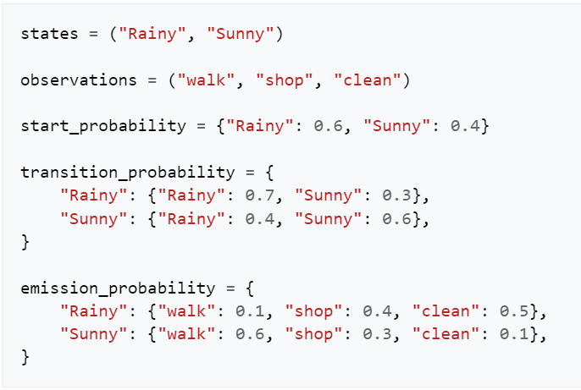
I. Hidden Markov Model
1. Basic concept:
State (aka hidden state in HMM): state of Markov chain at time t, be hidden.
Observations: can be observed and recorded, be relative with states at time t by emission probability

Slide 7
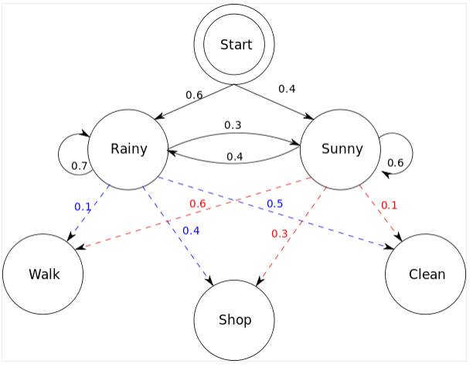
I. Hidden Markov Model
1. Basic Concept
State (aka hidden state in HMM): state of Markov chain at time t, be hidden.
Observations: can be observed and recorded, be relative with states at time t

Slide 8
I. Hidden Markov Model
2. Type of algorithms
Forward algorithm: find the probability of occurence of an observation sequence.
Viterbi algorithm: finds the most probable sequence of states for a given sequence of observations.
Baum-welch algorithm: finds the emission, start and transition probabilities most fits the data training.

Slide 9
II. Application in Fraud Detection
1. Fraud Detection Concept
Many different types of fraud transaction, little percentage of fraud in total.
Using supervised learning is not efficient, as:
Need to label fraud transaction by hand.
Imbalanced data
Model can’t learn from new types of fraud
→ Concept: A sequence is considered abnormal if its probability to happen is very low (lower than threshold)

Slide 10
II. Application in Fraud Detection
2. HMM in Fraud Detection Example
- State (be hidden): rich, poor, middle,… (Based on customer segmentation, can find n state for optimization by trying)
- Observation: Amount (100, 200, 300,…) → convert to low, high, middle by using intervals
Raw dataset
Customer ID | Date | Amount | Types
1 | 01/01 | 100 | Electric Bill
1 | 01/03 | 700 | House Rent
2 | 01/01 | 600 | Shopping

Slide 11
II. Application in Fraud Detection
2. HMM in Fraud Detection Example
- State (be hidden): rich, poor, middle,… (Based on customer segmentation, can find n state for optimization by trying)
- Observation: Amount (100, 200, 300,…) → convert to low, high, middle by using intervals
Raw dataset
Customer ID | Date | Amount | Types
1 | 01/01 | 100 | Electric Bill
1 | 01/03 | 700 | House Rent
2 | 01/01 | 600 | Shopping

Slide 12
II. Application in Fraud Detection
2. HMM in Fraud Detection Example
- State (be hidden): state can be types of transactions
- Observation: Amount (100, 200, 300,…) → convert to low, high, middle by using intervals
Raw dataset
Customer ID | Date | Amount | Types
1 | 01/01 | 100 | Electric Bill
1 | 01/03 | 700 | House Rent
2 | 01/01 | 600 | Shopping

Slide 13
II. Application in Fraud Detection
2. HMM in Fraud Detection Example
Example: a ATM card of FTU student can be used for tuition (>10 millions), class funding (5-10k) or buying milk tea (30-50k)
Raw dataset
Customer ID | Date | Amount | Types
1 | 01/01 | 100 | Electric Bill
1 | 01/03 | 700 | House Rent
2 | 01/01 | 600 | Shopping

Slide 14
II. Application in Fraud Detection
2. HMM in Fraud Detection Example
- Step 1: Train model for finding the emission, start and transition probabilities
- Using 1 model for all customer ID → 1 set of general parameters.
Train dataset
(not contains fraud transaction)
Cus ID | Amount 1 | Amount 2 | Amount 3
1 | 100 (Low) | 700 (Low) | 400 (Medium)
3 | 600 (High) | 400 (Medium) | 500 (Medium)

Slide 15
II. Application in Fraud Detection
Latest transaction
2. HMM in Fraud Detection Example
- Step 2: Use the general parameter for estimating probability of occurrence of sequence
Example: Sequence 1: L-H-M-H
Sequence 2: L-H-M
Sequence 3: H-M-M-H
Testing fraud transaction
Cus ID | Amount 1 | Amount 2 | Amount 3 | Amount 4
1 | 100 (Low) | 700 (High) | 400 (Medium) | 600 (High)
2 | 100 (Low) | 600 (High) | 400 (Medium)
3 | 600 (High) | 400 (Medium) | 500 (Medium) | 700 (High)
Not in train set, still can be tested.
Train set

Slide 16
II. Application in Fraud Detection
Latest transaction
2. HMM in Fraud Detection Example
Sequence 1: L-H-M-H
Sequence 2: L-H-M
Sequence 3: H-M-M-H
Basic:
- Step 3: If proba of sequence is lower than threshold → fraud trans
Or:
Testing fraud transaction
Cus ID | Amount 1 | Amount 2 | Amount 3 | Amount 4
1 | 100 (Low) | 700 (High) | 400 (Medium) | 600 (High)
2 | 100 (Low) | 600 (High) | 400 (Medium)
3 | 600 (High) | 400 (Medium) | 500 (Medium) | 700 (High)
Not in train set, still can be tested.
Train set

Slide 17
II. Application in Fraud Detection
Latest transaction
2. HMM in Fraud Detection Example
Advanced:
- Step 3: set n obs be a sequences.
P(O0, O1, … On) = a1
P(O1, O2,… On , On+1) = a2
If : (a1 – a2)/a1 <= t → On+1 be fraud transaction.
Testing fraud transaction
Cus ID | Amount 1 | Amount 2 | Amount 3 | Amount 4
1 | 100 (Low) | 700 (High) | 400 (Medium) | 600 (High)
2 | 100 (Low) | 600 (High) | 400 (Medium)
3 | 600 (High) | 400 (Medium) | 500 (Medium) | 700 (High)
Not in train set, still can be tested.
Train set

Slide 18
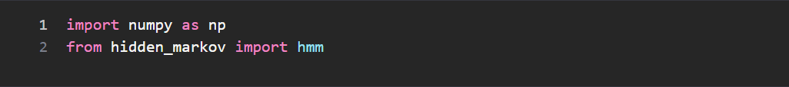
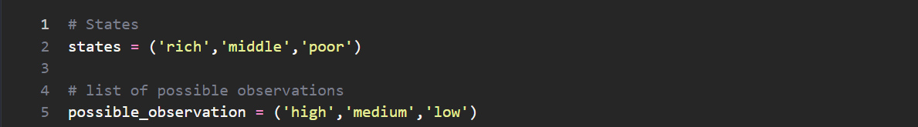
III. Example in Jupyter Notebook

Slide 19
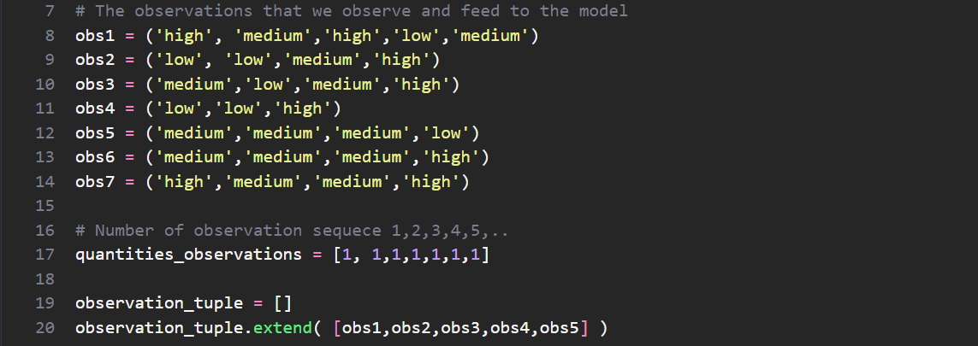
III. Example in Jupyter Notebook

Slide 20
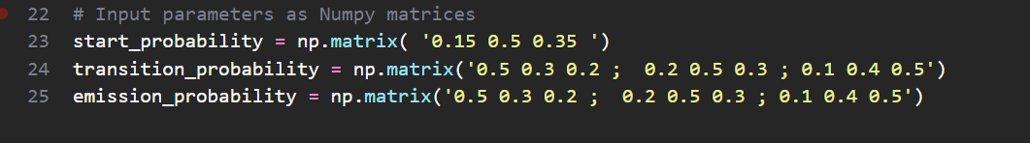
III. Example in Jupyter Notebook

Slide 21
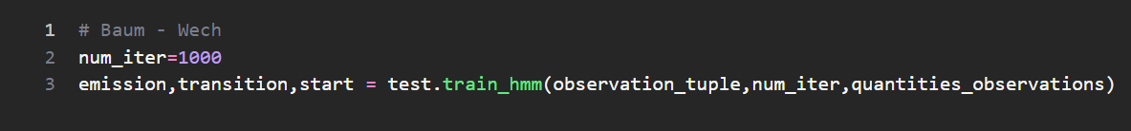
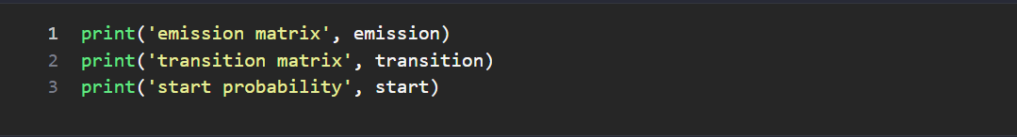
III. Example in Jupyter Notebook

Slide 22
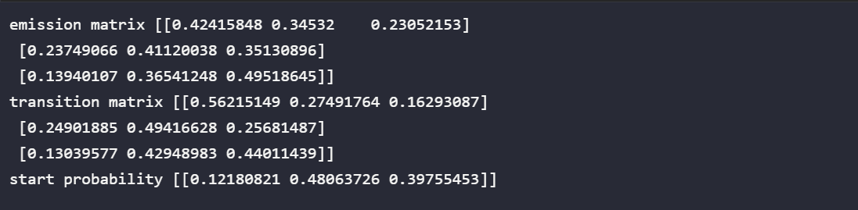
III. Example in Jupyter Notebook

Slide 23
Thanks for listening

